Slide 1
______ __ ________ ______ ___ ___ _________ ________ ______ ___ ___ ________ ___ __ _______ /_____/\ /_/\ /_______/\/_____/\ /___/\/__/\ /________/\/_______/\ /_____/\ /___/\/__/\ /_______/\/__/\ /__/\ /______/\ \:::__\/ \:\ \ \__.::._\/\:::__\/ \::.\ \\ \ \\__.::.__\/\::: _ \ \\:::__\/ \::.\ \\ \ \\__.::._\/\::\_\\ \ \\::::__\/__ \:\ \ __\:\ \ \::\ \ \:\ \ __\:: \/_) \ \ /_\::\ \ \::(_) \ \\:\ \ __\:: \/_) \ \ \::\ \ \:. `-\ \ \\:\ /____/\ \:\ \/_/\\:\ \____ _\::\ \__\:\ \/_/\\:. __ ( ( \:.\::\ \ \:: __ \ \\:\ \/_/\\:. __ ( ( _\::\ \__\:. _ \ \\:\\_ _\/ \:\_\ \ \\:\/___/\/__\::\__/\\:\_\ \ \\: \ ) \ \ \: \ \ \ \:.\ \ \ \\:\_\ \ \\: \ ) \ \/__\::\__/\\. \`-\ \ \\:\_\ \ \ \_____\/ \_____\/\________\/ \_____\/ \__\/\__\/ \_____\/ \__\/\__\/ \_____\/ \__\/\__\/\________\/ \__\/ \__\/ \_____\/

Slide 2
Clickjacking (UI Redress)
When the attacker uses multiple transparent or opaque layers to trick a user into clicking on a button or link on another page when they were intending to click on the top level page
Clicks are “hijacked” and routed to another page
You can kind of think of it as a more involved and more “physical” CSRF attack

Slide 3
Example
Assumption: victim is logged into social network
Imagine a page with a “click to view embarrassing photos” link
On top of that page (and invisible to the user) the attack has loaded an iFrame with their page on a social network
The attacker lines up the “add friend” button on their profile page up with the “click to view” link
When the user clicks to view the embarrassing photos they are actually clicking the “add friend” button
The user is tricked into adding the attacker as their friend on the social network

Slide 4
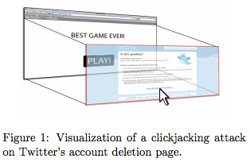

Slide 5
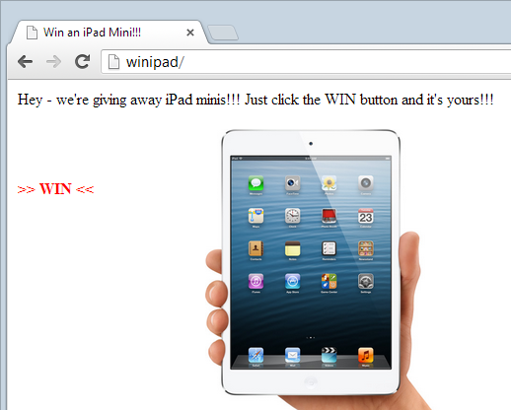

Slide 6
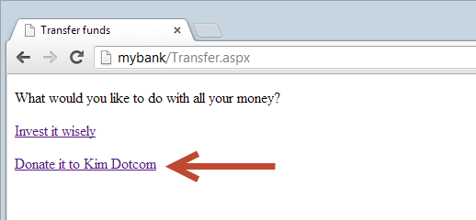

Slide 7


Slide 8
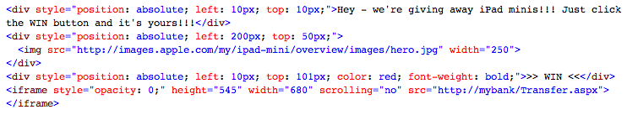
Code Example

Slide 9
Two Main Defenses
X-Frame-Options HTTP response header
Framebusting UI code

Slide 10
X-Frame-Options header
The only “real” solution
Tells the browser whether a requested page can be framed
Can be tweaked per page
Three values:
DENY - no framing period
SAMEORIGIN - can only be framed in the same domain
ALLOW-FROM - can only be framed by trusted pages

Slide 11
Framebusting UI code
Check to see if the page is same as the one loaded from the address bar
if (top.location != location) {
top.location = self.location;
}

Slide 12
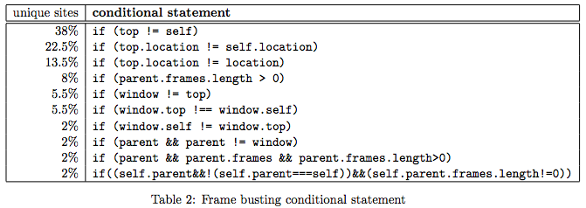
Common Defenses

Slide 13
Can anyone think of bypasses to these?

Slide 14
Framebusting Arms Race
Frame buster busters such as:
Nesting the victim site in two frames as the double framing causes the descendent frame navigation policy to disable redirection
Tapping into the onBeforeUnload event to cancel the redirection (albeit with some user input) when the frame buster attempts to unload the page
Exploiting XSS filters designed to prohibit Cross-Site Scripting in order to cancel out the frame buster

Slide 15
Can you think of a bypass?

Slide 16
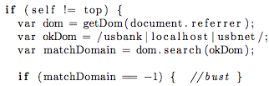
USBank framebusting

Slide 17
USBank framebusting issues
Still allows domains with the word usbank in it
Can be framed by:
http://www.husbanken.no
http://www.rusbank.org
Or any domain registered by an attacker with usbank in it

Slide 18
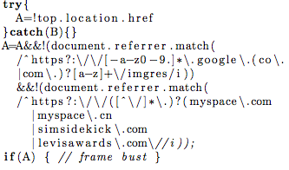
Myspace framebusting

Slide 19
Myspace framebusting issues
Allows for framing by Google images
Google images does not employ frame busting
An attack simply frames Google images and then cause Google images to frame Myspace

Slide 20
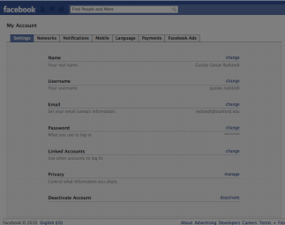
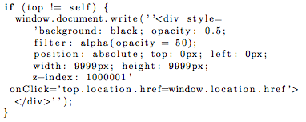
A Clever Clickjacking Protection
Facebook.com inserts a gray semi-transparent div that covers all of the content when a profile page is framed
Allows framing but blocks clickjacking attacks

Slide 21
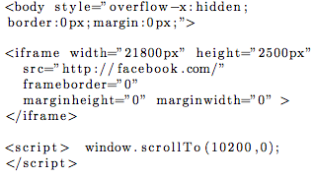
Facebook.com bypass
Make the enclosing frame so large that the center of the frame is outside of the dark div
The content centers itself automatically
The scrollTo function dynamically scrolls to the center

Slide 22
Resources
http://www.troyhunt.com/2013/05/clickjack-attack-hidden-threat-right-in.html
http://seclab.stanford.edu/websec/framebusting/framebust.pdf
https://www.owasp.org/index.php/Clickjacking

